Slide 1
Campus Management System
Student Portal

Slide 2
Campus Management System
Student Portal URL Using FUIC Website
http://fuic.fui.edu.pk/index.php/campus-management-system-cms Direct URL Using IP
For FUCN/FUIRS Students
http://59.103.181.148:9083/
For FUCD Students http://59.103.181.148:7072/

Slide 3
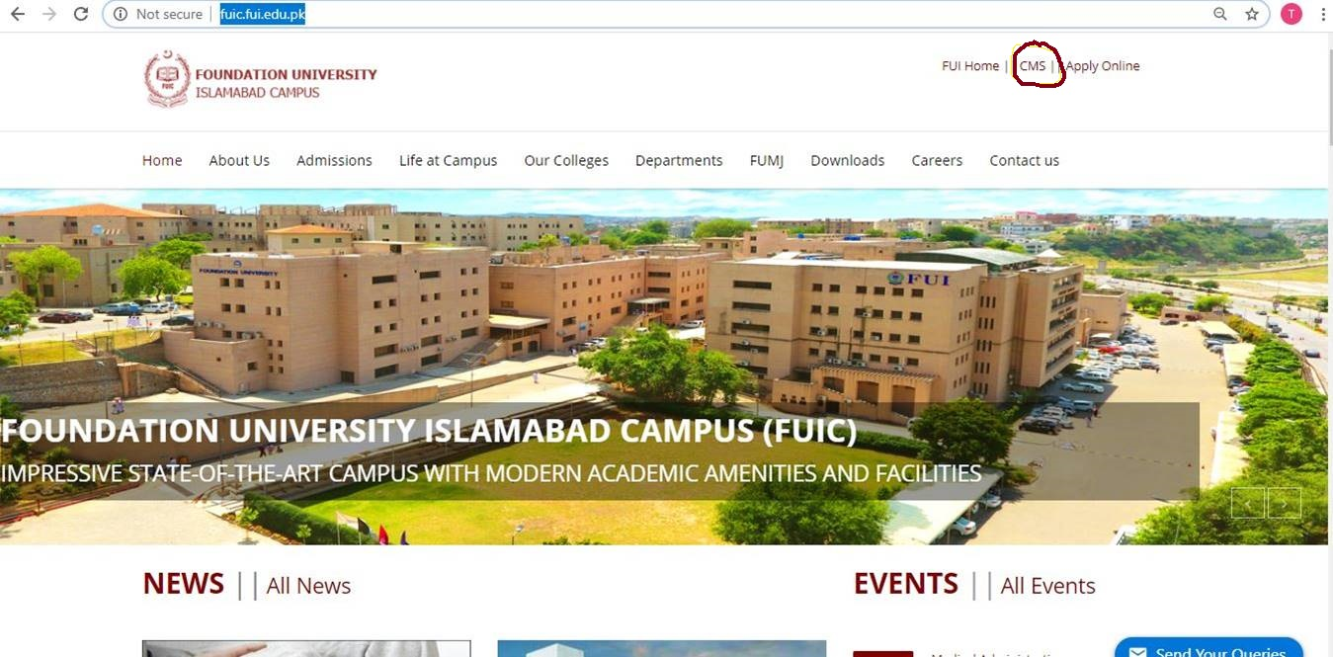
Campus Management System URL Using FUIC Website

Slide 4
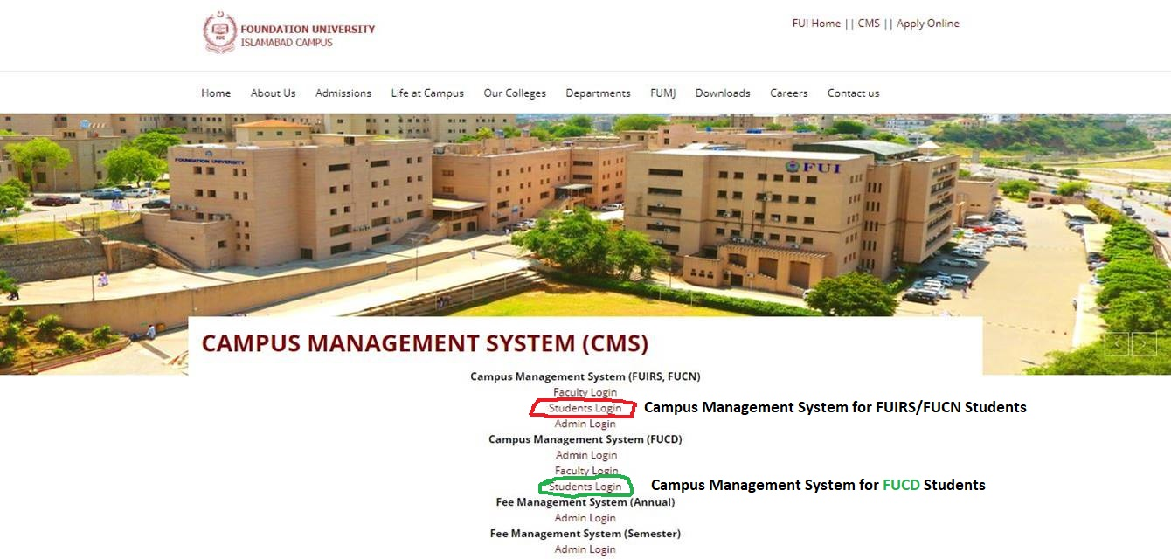
Campus Management System Links

Slide 5
Student Login Page
Campus Management System Student Login Window
1- For [User ID/Roll No] Student will select session, program and enter roll no in 3 digits.
2- User will enter his/her Password and then click Sign In

Slide 6
Campus Management System Student Dashboard

Slide 7
Campus Management System Course Registration->Register Courses
Student can check attendance summary of each course & CGPA Summary of each year/semester

Slide 8
Campus Management System Courses->Summary
Student can view total attendance, total absents, attendance % of each course. When student will click on the [Course Title] Quiz Assignment Marks of the course will be displayed.

Slide 9
Campus Management System Courses->Class Proceedings

Slide 10
Campus Management System Courses->Quiz Assignment Marks

Slide 11
Campus Management System Course Portal->Course Contents
Student can download course contents of each subject using this window

Slide 12
Campus Management System Course Portal->Assignments Summary

Slide 13
Campus Management System Course Portal->Pending Assignments

Slide 14
Campus Management System Result->Result Card

Slide 15
Campus Management System Settings->Profile
Student can change his/her contact information using this window

Slide 16
Campus Management System Settings->Change Password

Slide 17
Campus Management System Settings->Login History

